Slide 1
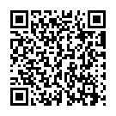


On the Convergent Validity of Offline Evaluation Designs for Recommender Systems
Sushobhan Parajuli, Samira Vaez Barenji, and Michael D. Ekstrand
INERTIA Laboratory, Drexel University
https://bit.ly/4gyIXRP

Slide 2
Motivation: The Reality of Sparse Data
The Tradition: Most recommender systems research relies on offline evaluation using historical logs.
The Problem: Historical data is sparse, biased, and Missing Not At Random (MNAR).
We don’t know if “better” offline scores reflect true user preferences or just the biases of the evaluation setup.

Slide 3
Measurement & Convergent Validity
Validity Framework: Evaluation is a form of measurement; it must be both reliable and valid.
Internal vs. External Validity: Does the metric measure what it’s supposed to (internal), and does it generalize to the real world (external)?
Convergent Validity: Do two measures intended to measure same construct produce consistent results?
Our Approach: Comparing sparse offline evaluation against dense ground-truth evaluation.

Slide 4
Research Questions
RQ1: To what extent do model rankings obtained from sparse offline evaluation correlate with rankings derived from dense ground-truth evaluation?
RQ2: Do modifications to offline evaluation (such as sampling, data filtering, or list length) reduce the gap between these evaluations?

Slide 5
Core Insight
Different sparse designs disagree with each other, but disagreement alone doesn’t say which is right.
What is dense ground-truth?
  MovieLens: 51 users directly rate pooled recs
  KuaiRec: a small matrix, near-full catalog exposure
A proxy for true preferences: sparse-vs-dense agreement becomes a validity check.

Slide 6
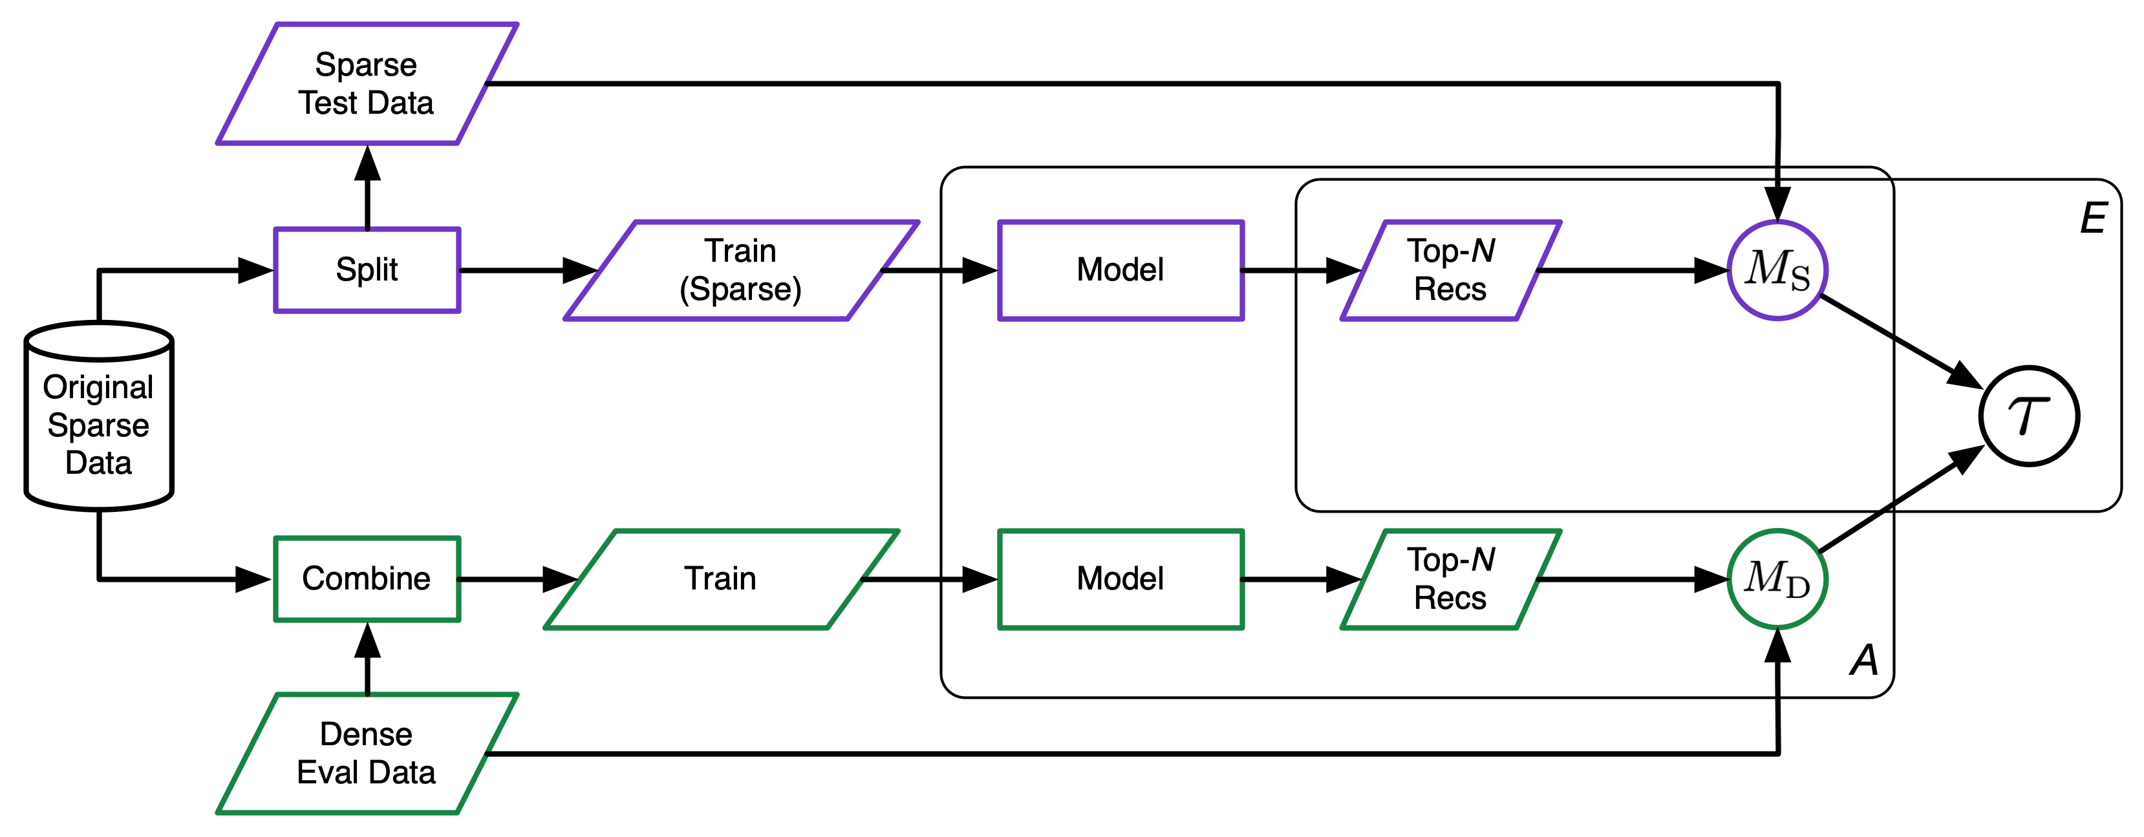
Research Design

Slide 7
Methods: Models and Design Factors
Models: 45 base recommendation models, resulting in 97 (MovieLens-32M) and 123 (KuaiRec) model configurations.
Varying Evaluation Designs:
Candidate Sets: Full set vs. Uniform (U-1000) vs. Popularity-weighted (P-1000) sampling.
Relevance Thresholds: Binary vs. Graded feedback.
List Length: Evaluating at cutoffs 10, 20, and 100.

Slide 8
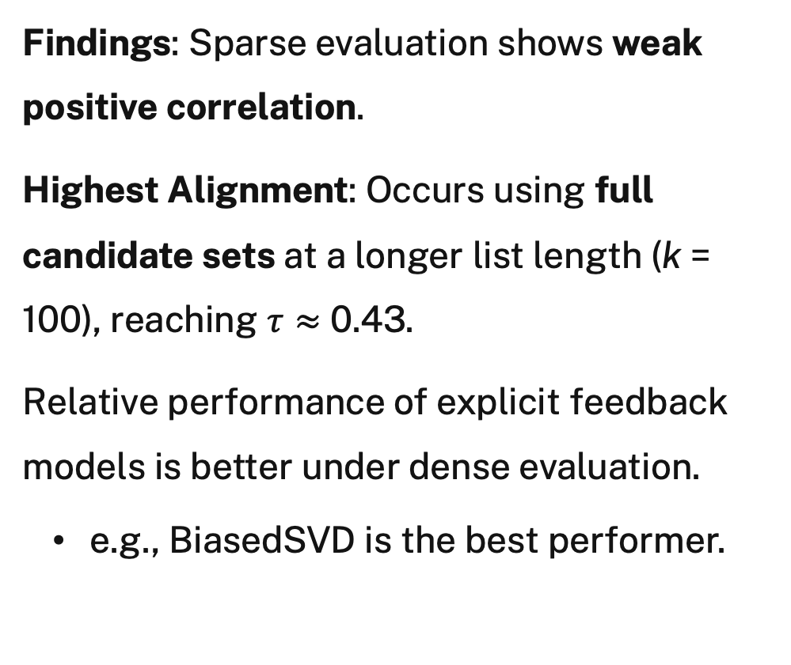
Results: MovieLens
BiasedSVD
Findings: Sparse evaluation shows weak positive correlation.
Highest Alignment: Occurs using full candidate sets at a longer list length (k = 100), reaching $τ≈$ 0.43.
Relative performance of explicit feedback models is better under dense evaluation.
  e.g., BiasedSVD is the best performer.

Slide 9
Results: KuaiRec
Ranking Inversion: Sparse evaluation is negatively correlated with dense ground truth.
Key Insight: Sparse evaluation inverts the dense ranking regardless of the design choice.
Implication: Sparse best models are among the worst when measured against denser user feedback.

Slide 10
Findings on Evaluation Design Choices
Candidate Sets: Full candidate sets generally outperform sampled ones in correlating with dense data.
  Popularity-weighted sampling was useful for short lists on MovieLens.
Relevance Thresholds: Binary thresholds generally produce higher correlations than graded evaluation on MovieLens.
List Length: The length of the recommendation list has only a small effect on rank correlation.

Slide 11
Summary & Takeaway
Validity is Dataset-Dependent: Correlation ranges from weakly positive to strongly negative depending on the dataset.
Design Matters: Model differences may be driven as much by evaluation protocol as by actual model effectiveness.
The Takeaway: Researchers must look beyond sparse offline metrics; a model’s “success” on a sparse evaluation does not guarantee it reflects true user preferences.
Acknowledgements: NSF Grant No. IIS 24-09199 https://bit.ly/4gyIXRP

